Slide 1
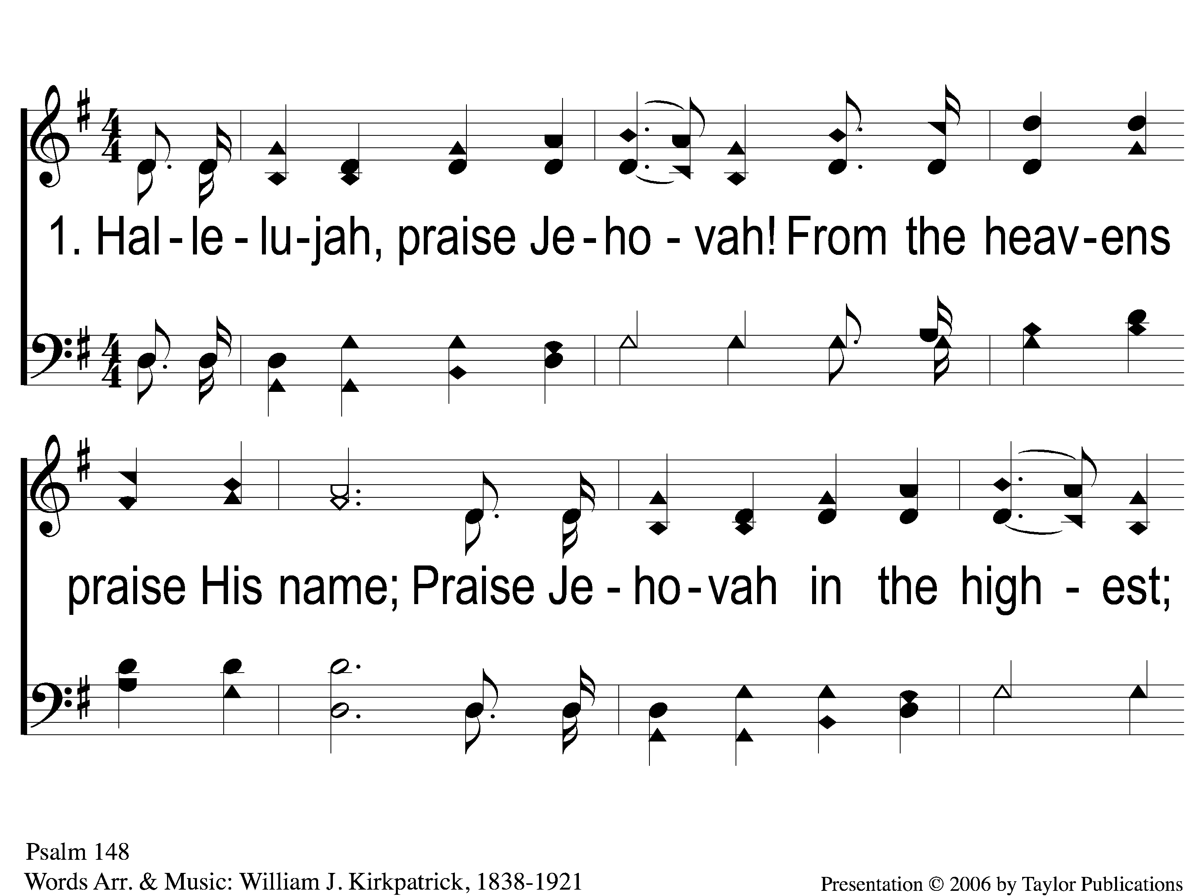
1-1 Hallelujah Praise Jehovah
Hallelujah, Praise Jehovah!
148

Slide 2
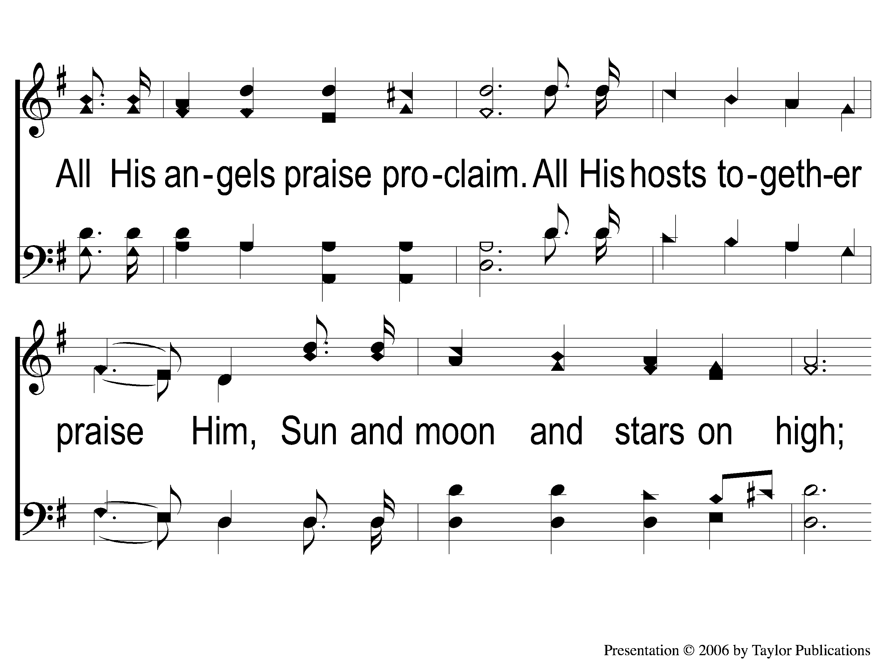
1-2 Hallelujah Praise Jehovah
Hallelujah, Praise Jehovah!
148

Slide 3
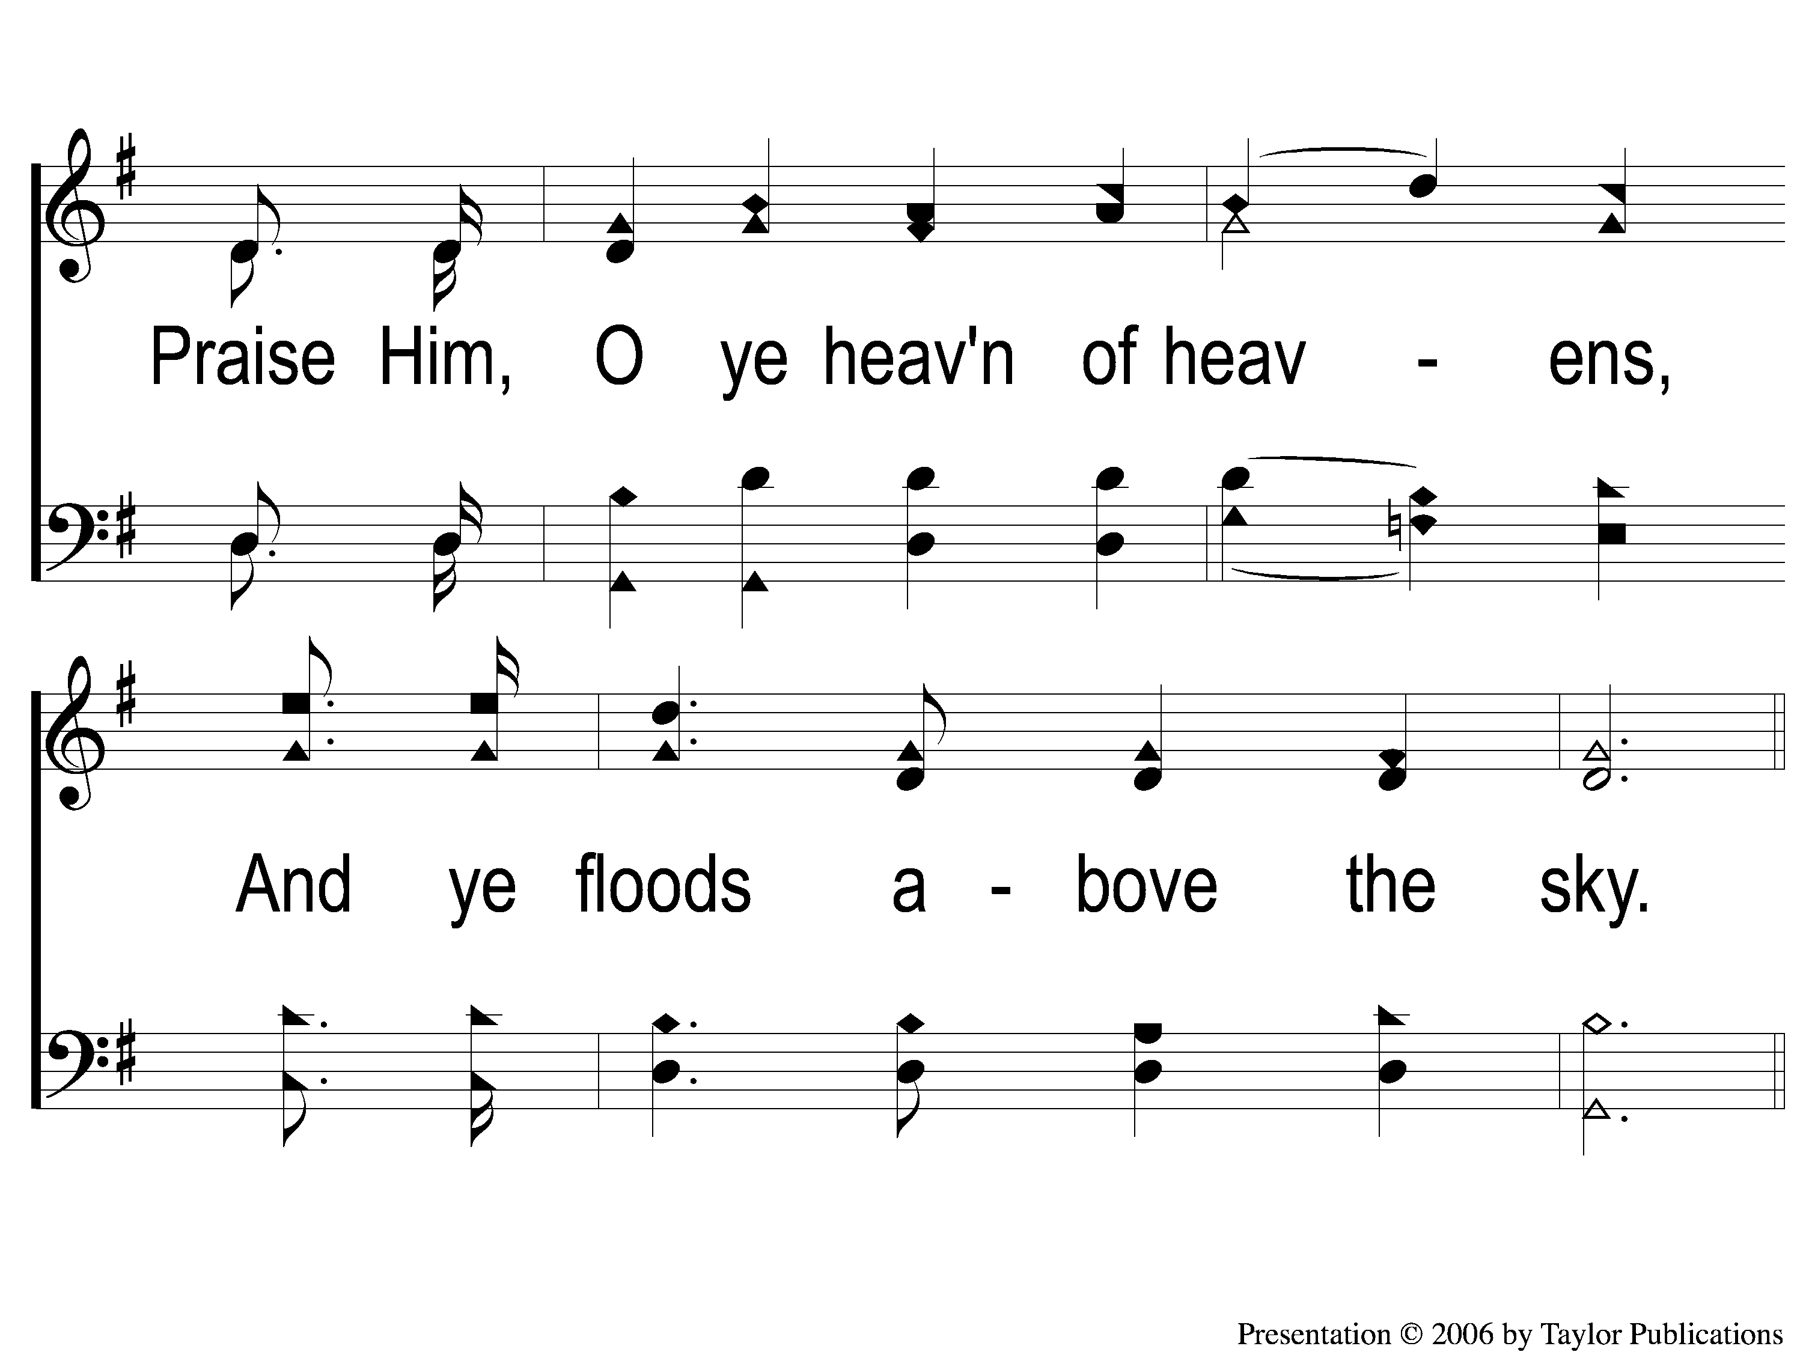
1-3 Hallelujah Praise Jehovah
Hallelujah, Praise Jehovah!
148

Slide 4
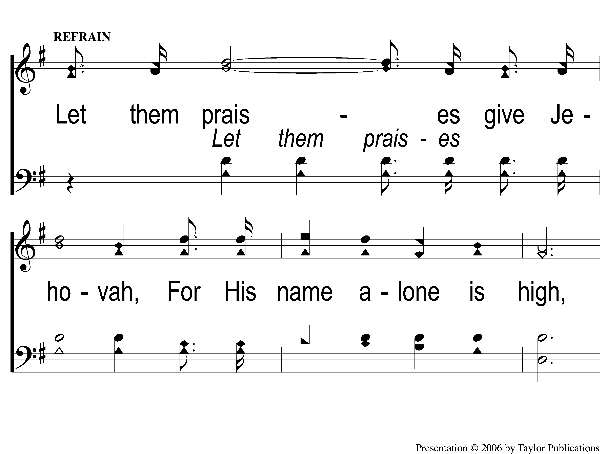
C-1 Hallelujah Praise Jehovah
Hallelujah, Praise Jehovah!
148

Slide 5
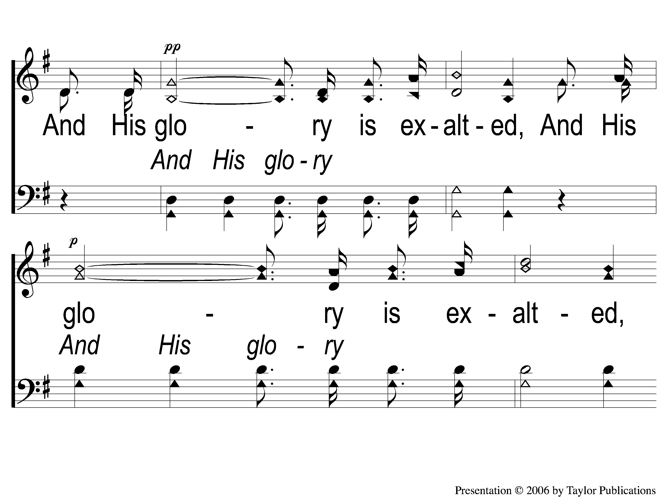
C-2 Hallelujah Praise Jehovah
Hallelujah, Praise Jehovah!
148

Slide 6
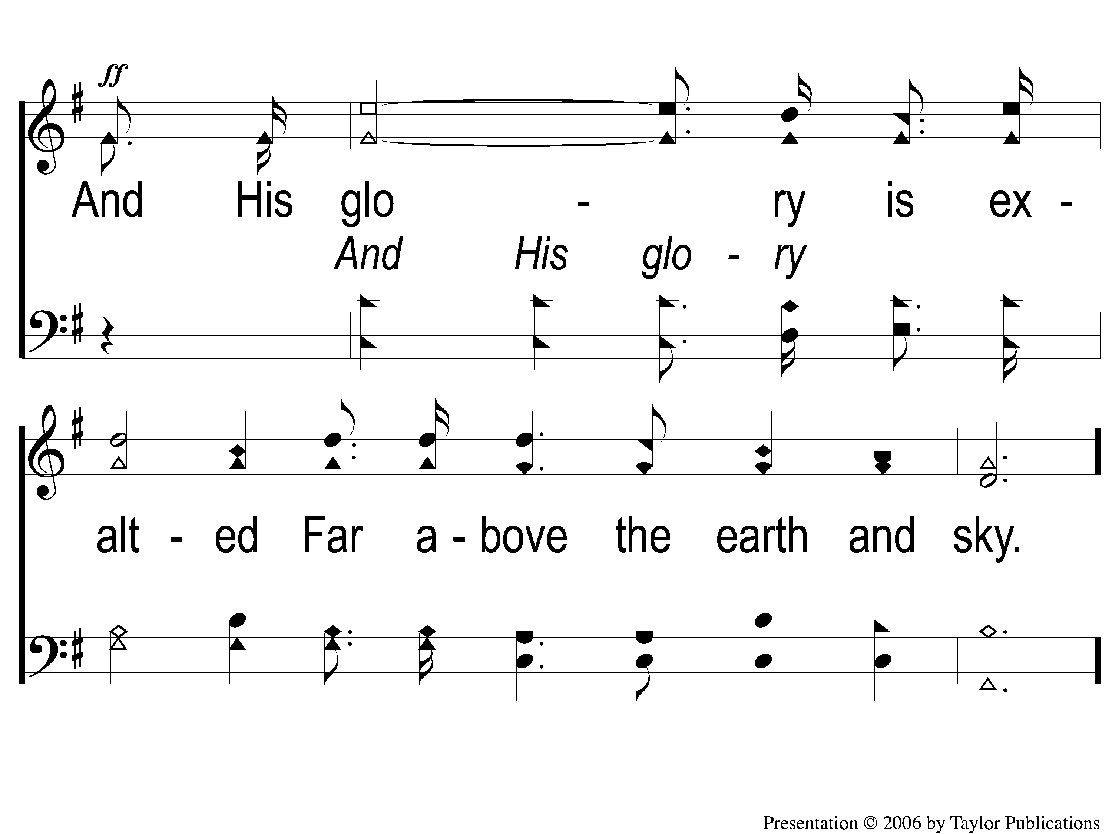
C-3 Hallelujah Praise Jehovah
Hallelujah, Praise Jehovah!
148

Slide 7
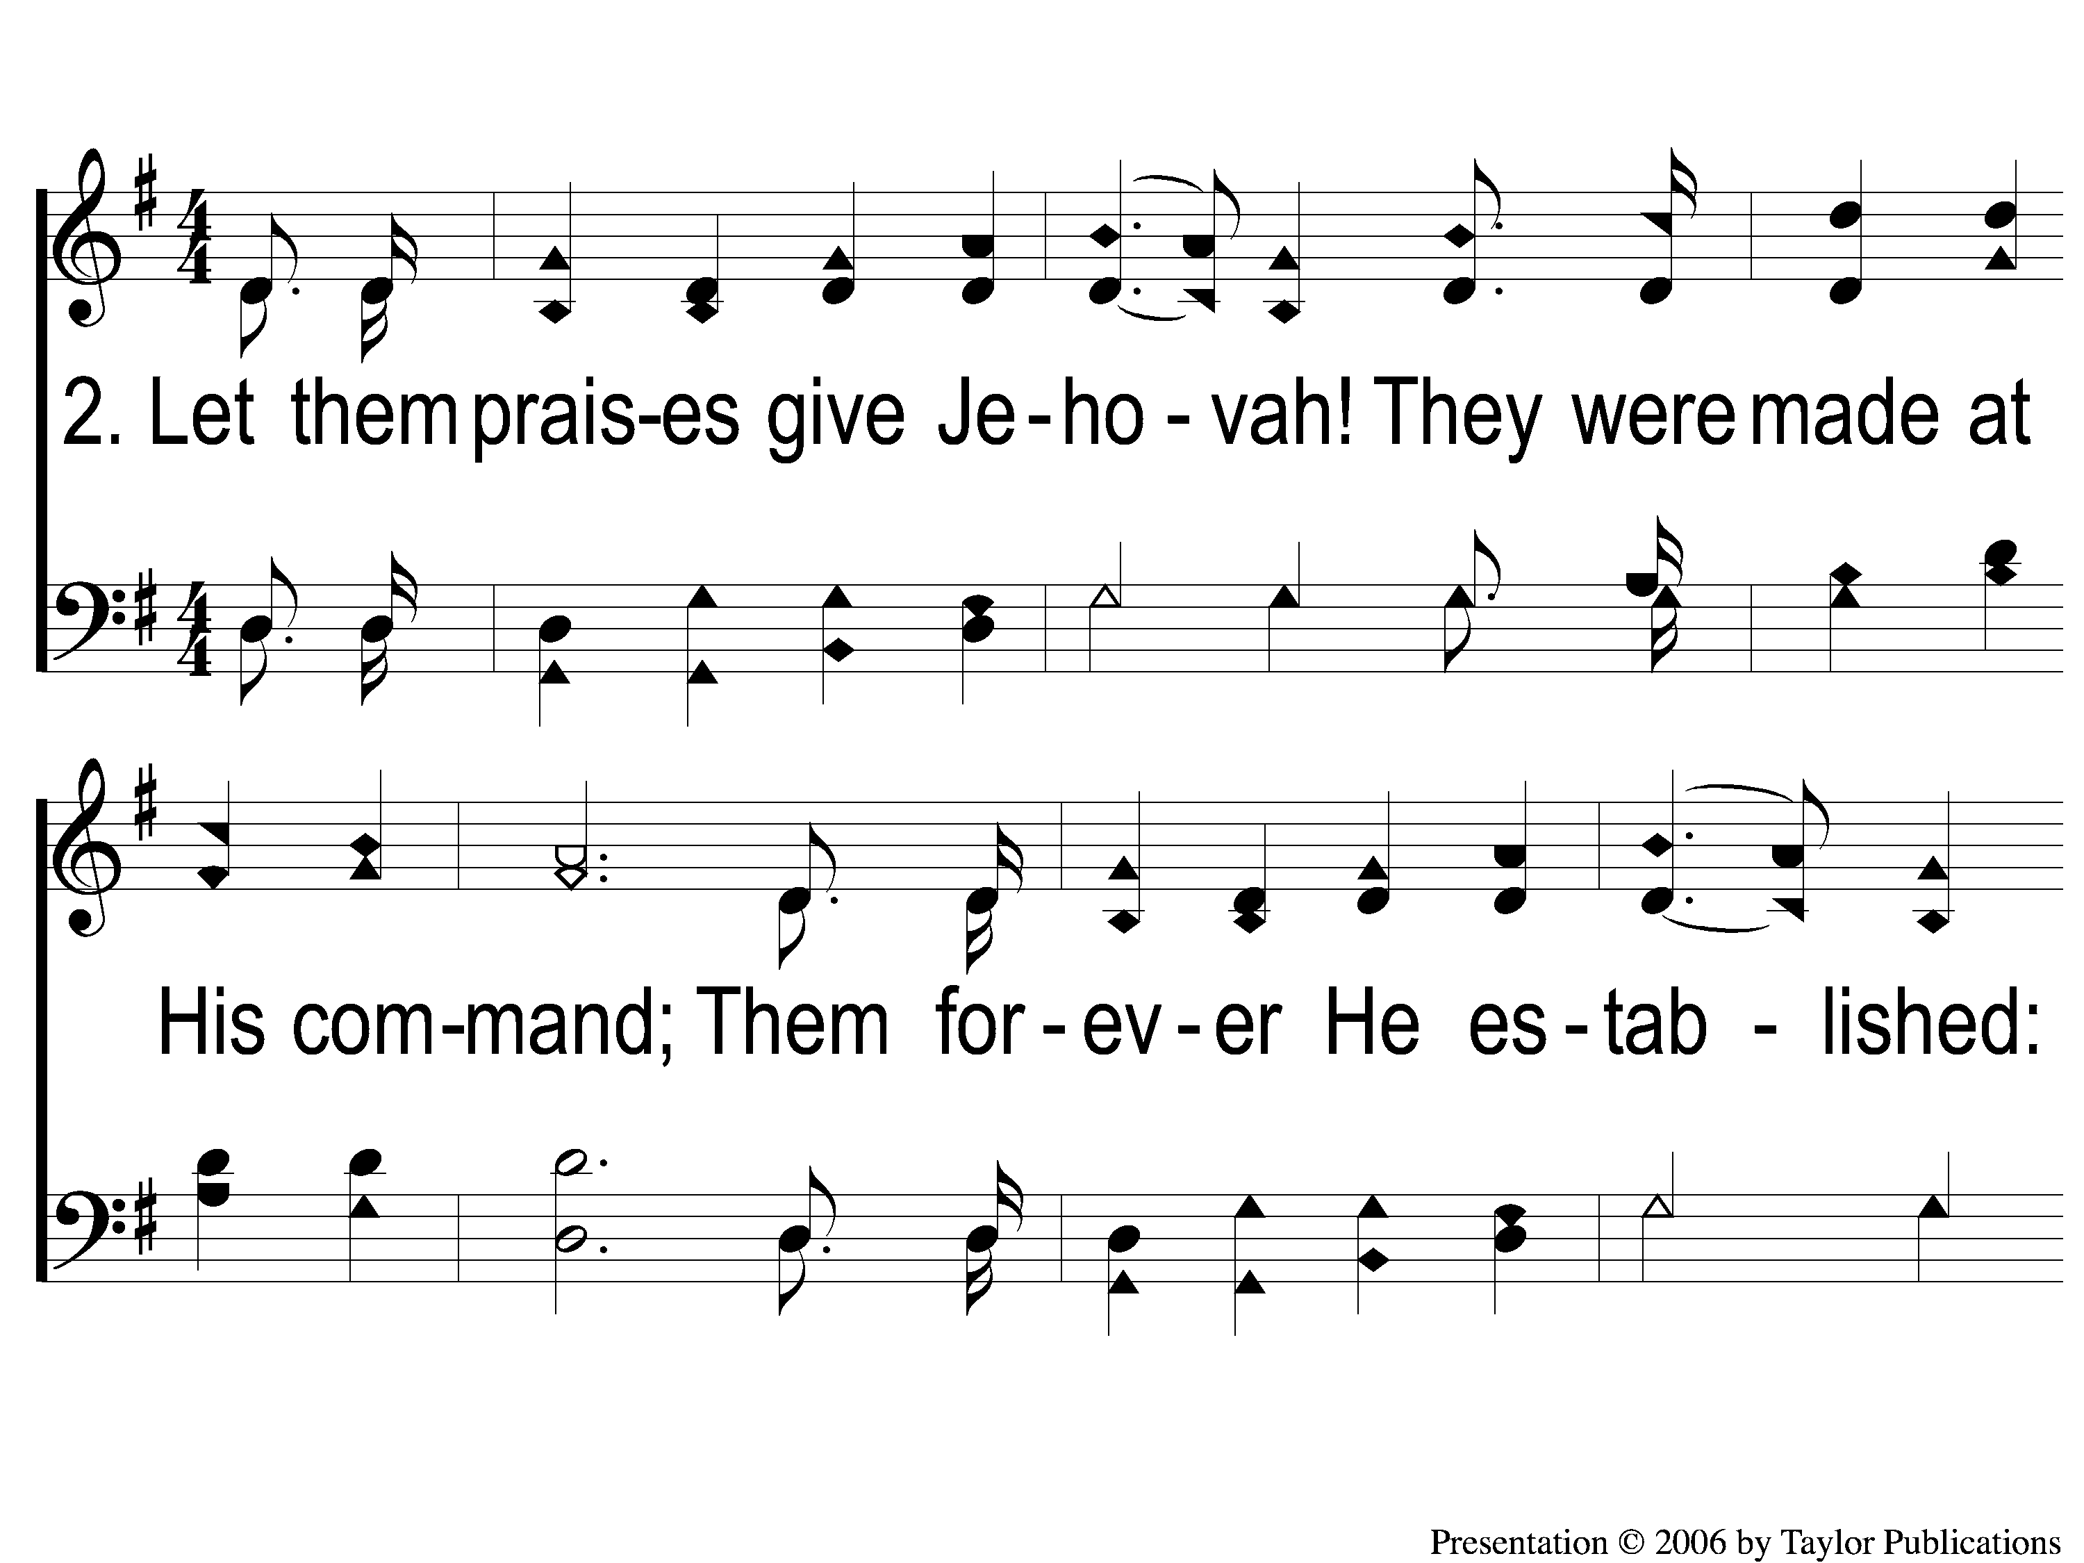
2-1 Hallelujah Praise Jehovah
Hallelujah, Praise Jehovah!
148

Slide 8
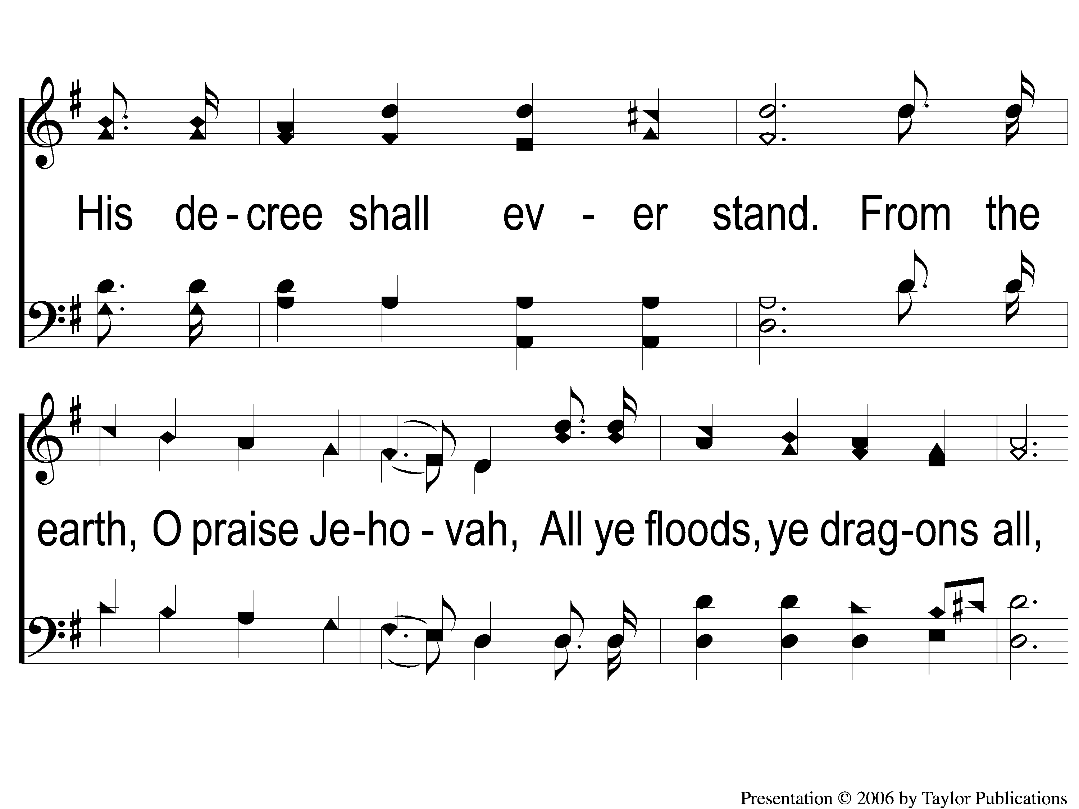
2-2 Hallelujah Praise Jehovah
Hallelujah, Praise Jehovah!
148

Slide 9
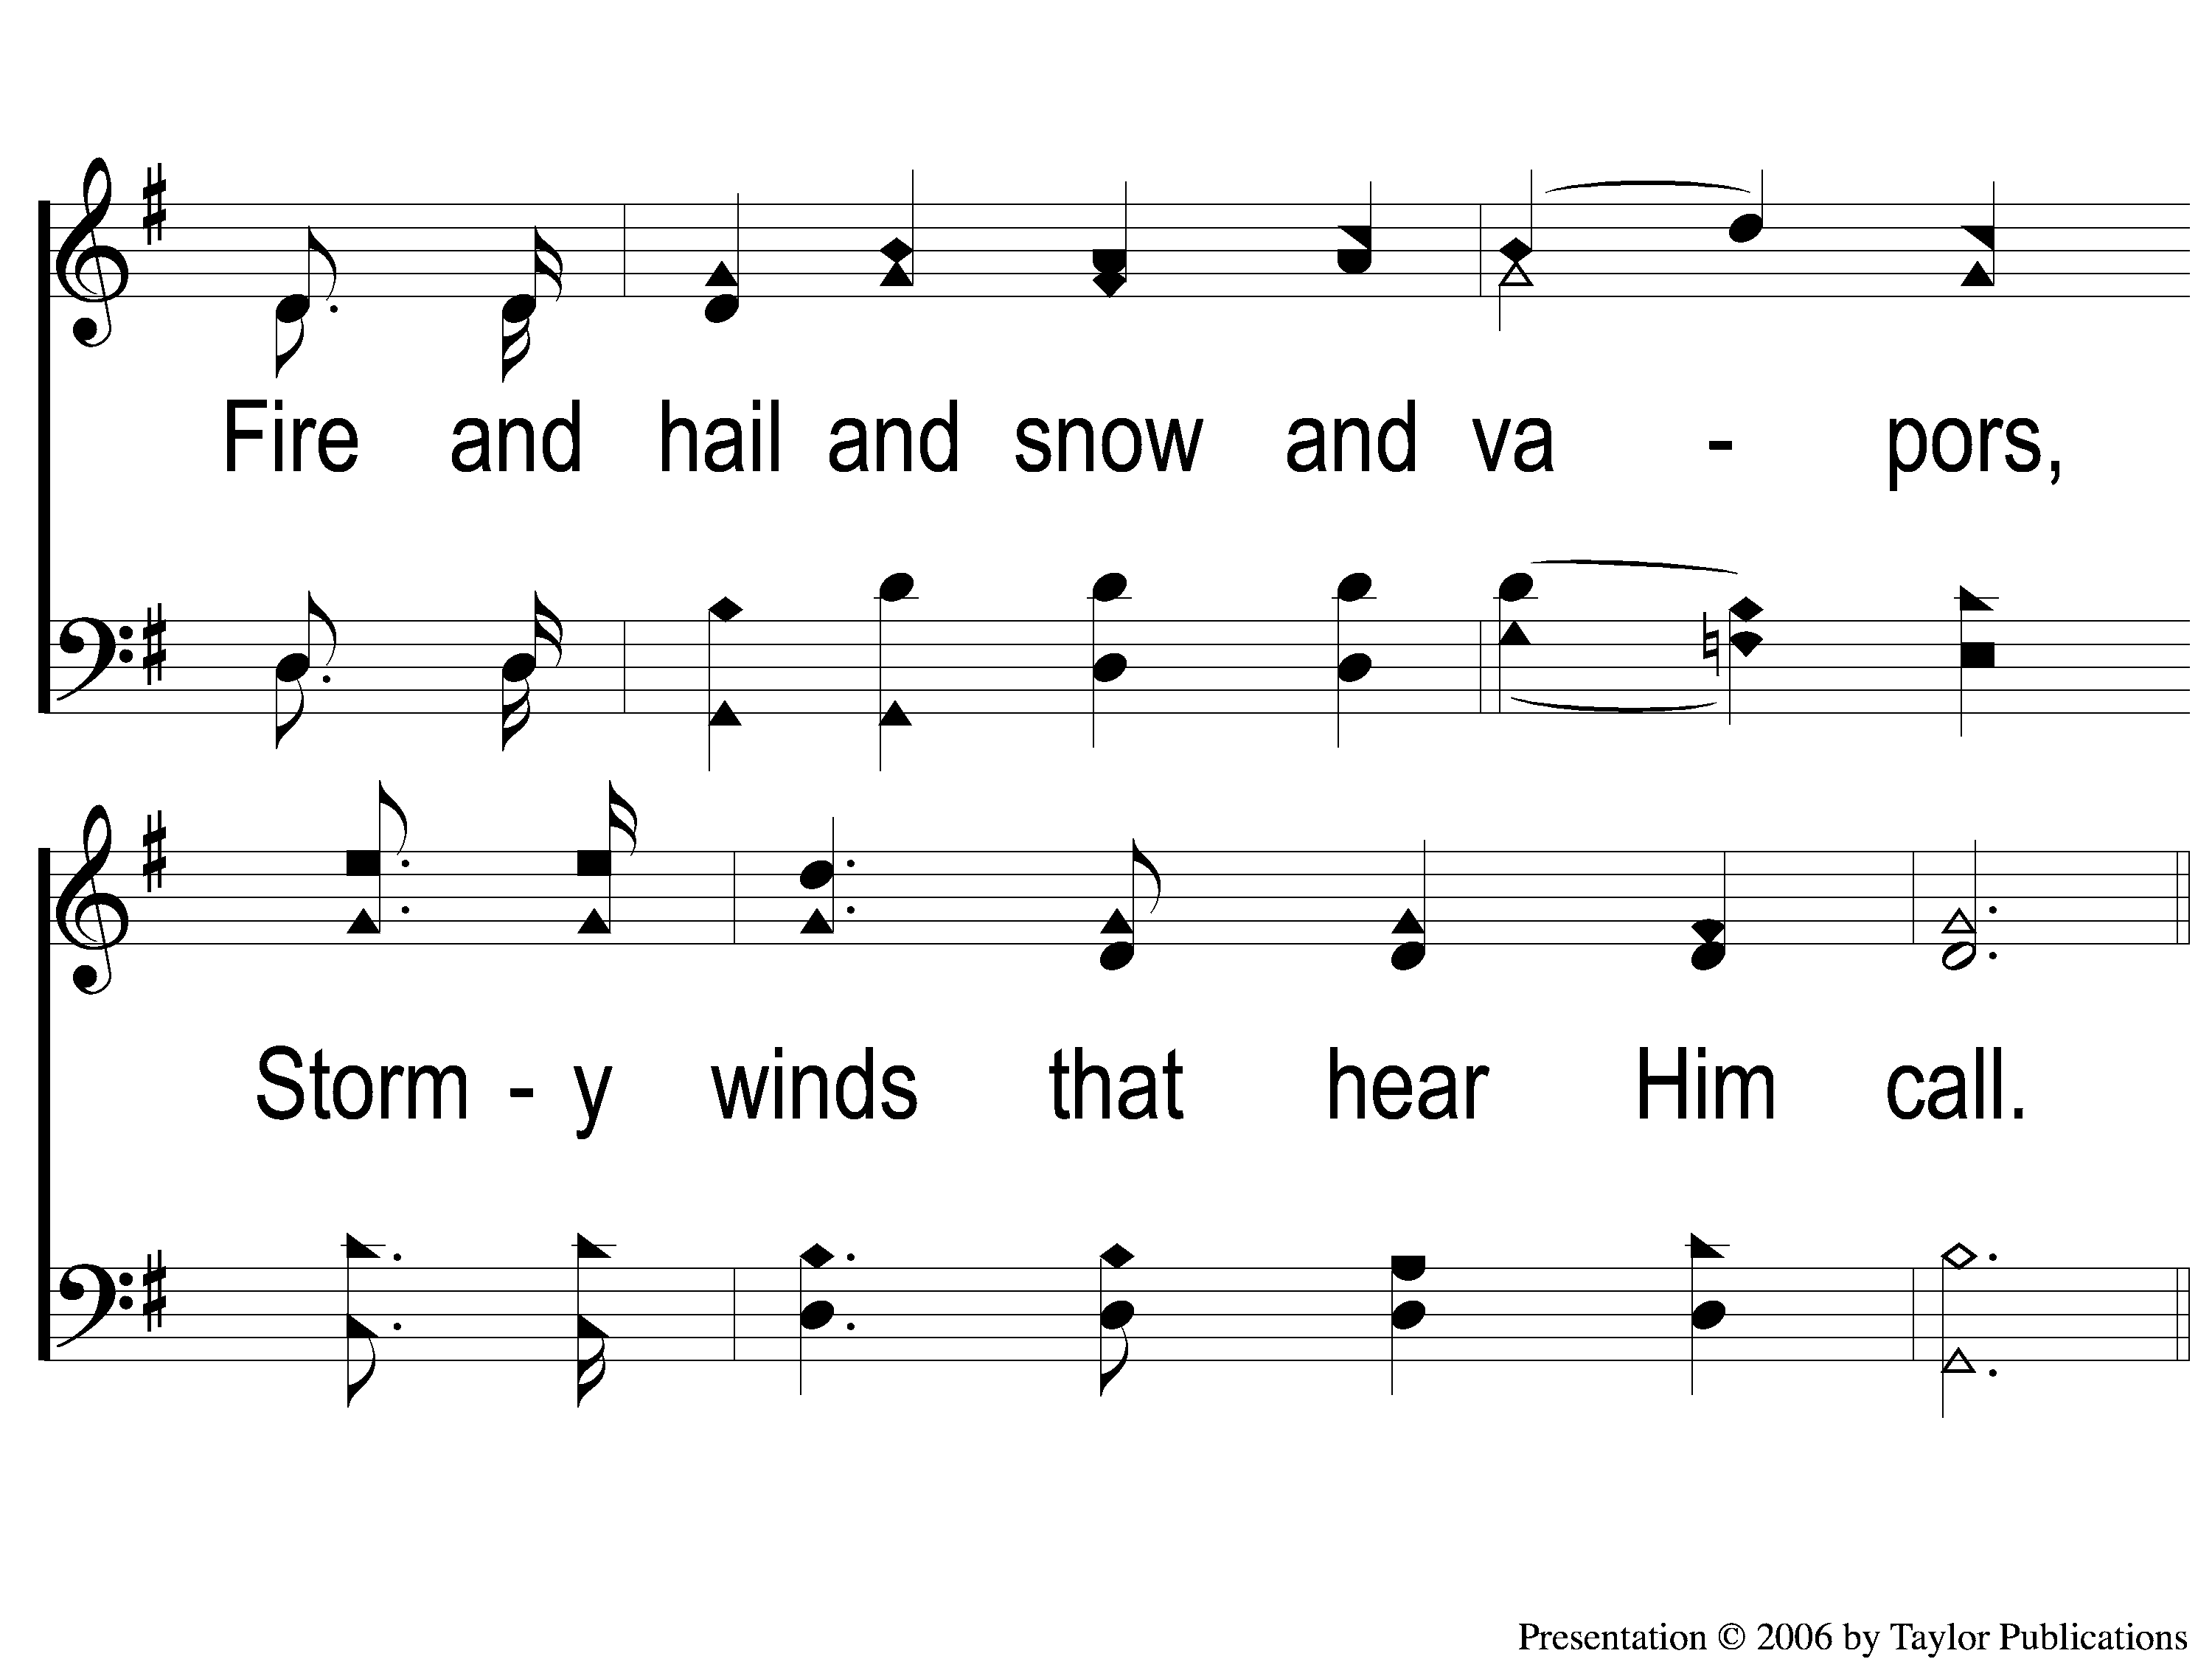
2-3 Hallelujah Praise Jehovah
Hallelujah, Praise Jehovah!
148

Slide 10
C-1 Hallelujah Praise Jehovah
Hallelujah, Praise Jehovah!
148

Slide 11
C-2 Hallelujah Praise Jehovah
Hallelujah, Praise Jehovah!
148

Slide 12
C-3 Hallelujah Praise Jehovah
Hallelujah, Praise Jehovah!
148

Slide 13
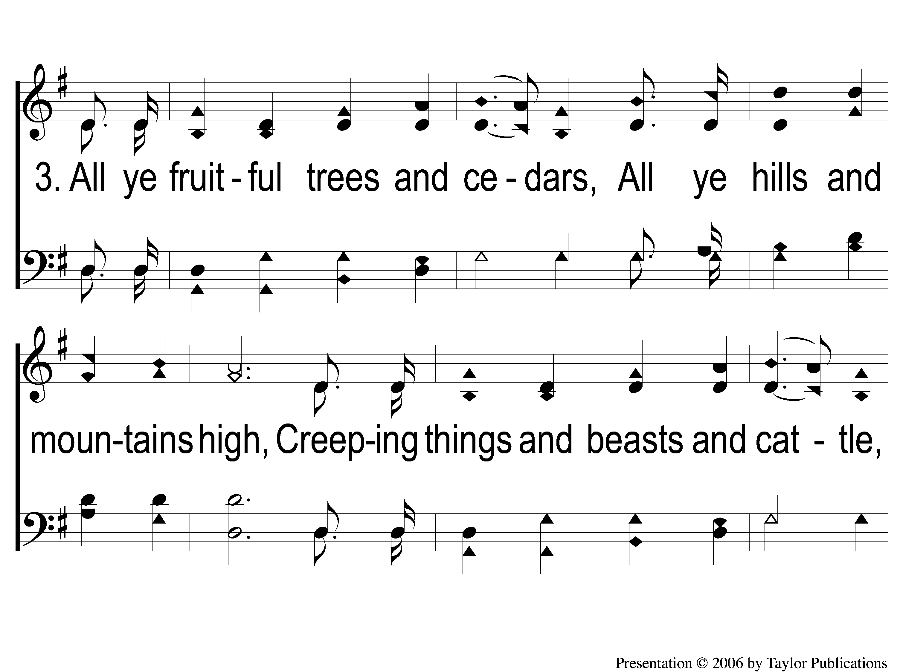
3-1 Hallelujah Praise Jehovah
Hallelujah, Praise Jehovah!
148

Slide 14
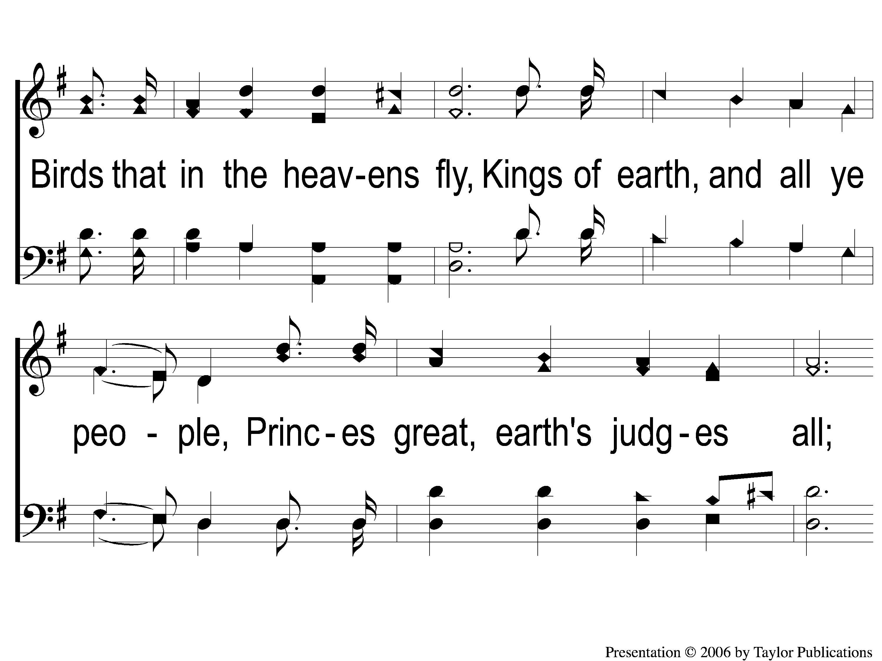
3-2 Hallelujah Praise Jehovah
Hallelujah, Praise Jehovah!
148

Slide 15
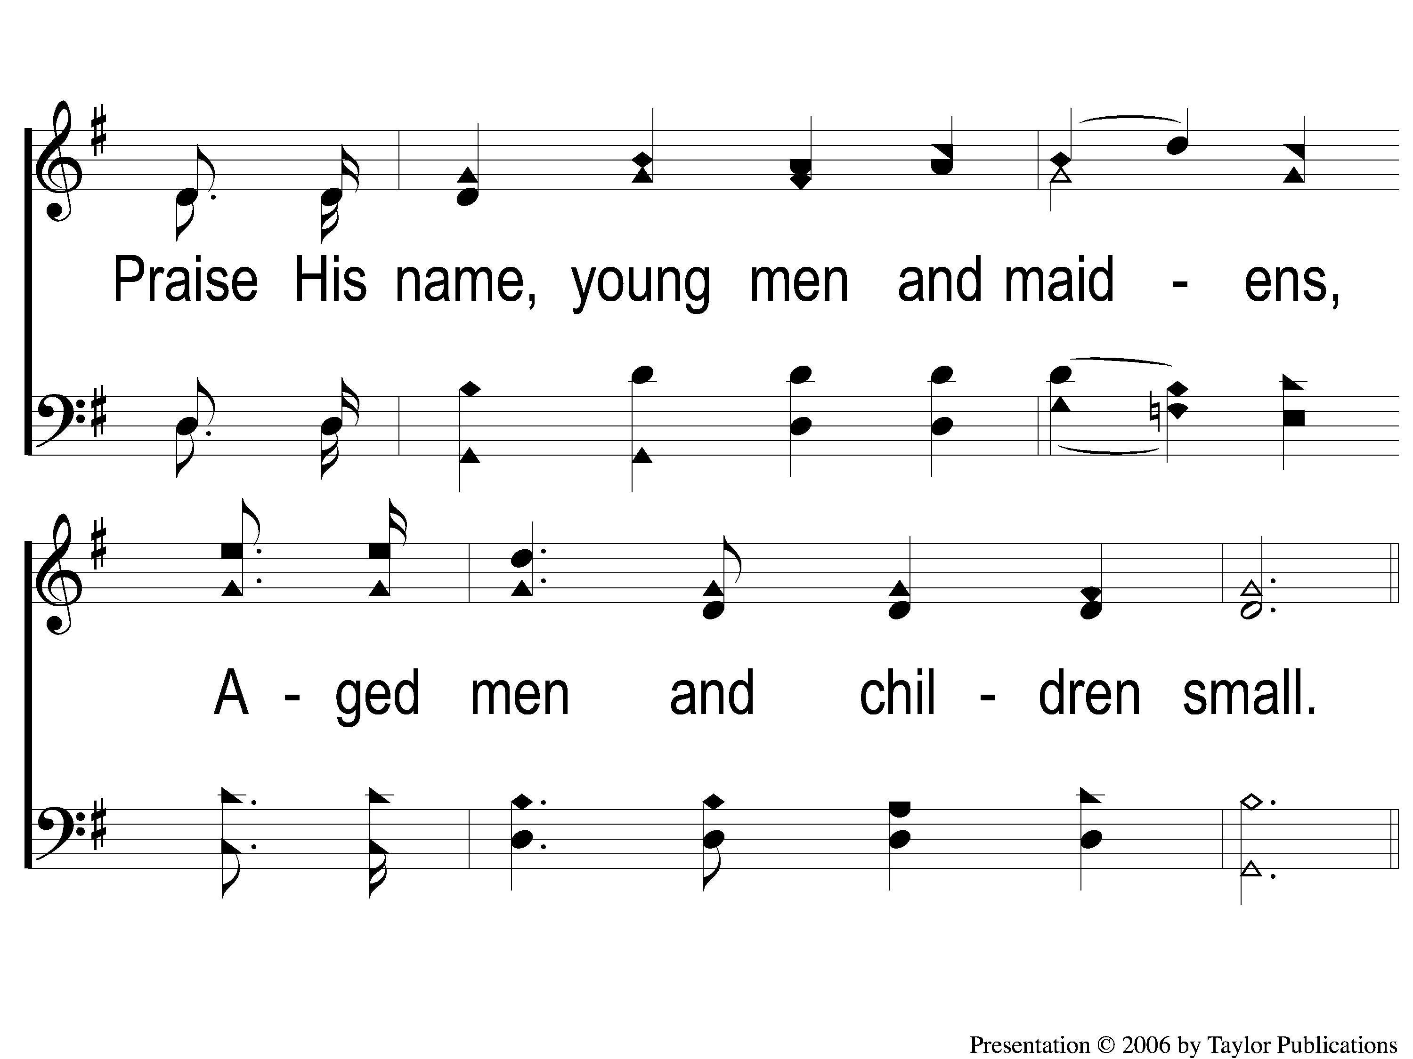
3-3 Hallelujah Praise Jehovah
Hallelujah, Praise Jehovah!
148

Slide 16
C-1 Hallelujah Praise Jehovah
Hallelujah, Praise Jehovah!
148

Slide 17
C-2 Hallelujah Praise Jehovah
Hallelujah, Praise Jehovah!
148

Slide 18
C-3 Hallelujah Praise Jehovah
Hallelujah, Praise Jehovah!
148

